Slide 1
Topic diploma thesis Daniel Fischer
TU Dresden
Chair of Transport Processes at Interfaces
10.06.2022

Slide 2
Case h = 0.4mm
3 different mesh sizes to start with
  t_exp = 550s
  r = 40 mm
mesh | coarse | medium | fine
Element size [m] | 1,2e-5 | 0,8e-5 | 0,4e-5
n Elements | 123.358 | 270.000 | 1.040.000
Computational Time [h] | ~ 11,5 | ~ 22,5 | ~ 63
Computational Resources [Nodes x CPUs] | 1x40 | 1x40 | 1x40

Slide 3
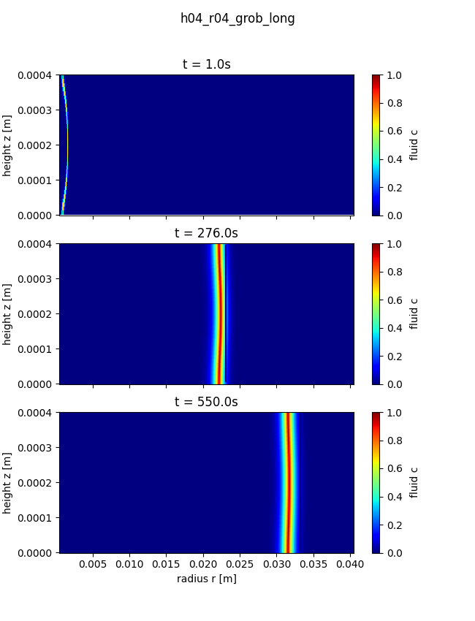
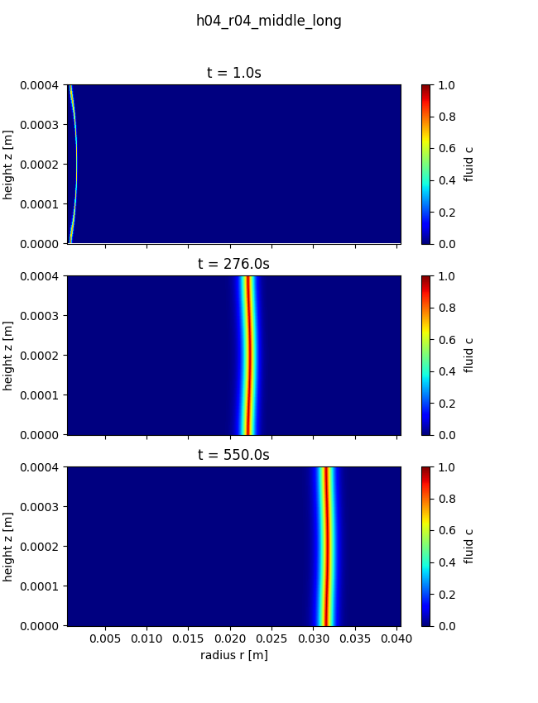
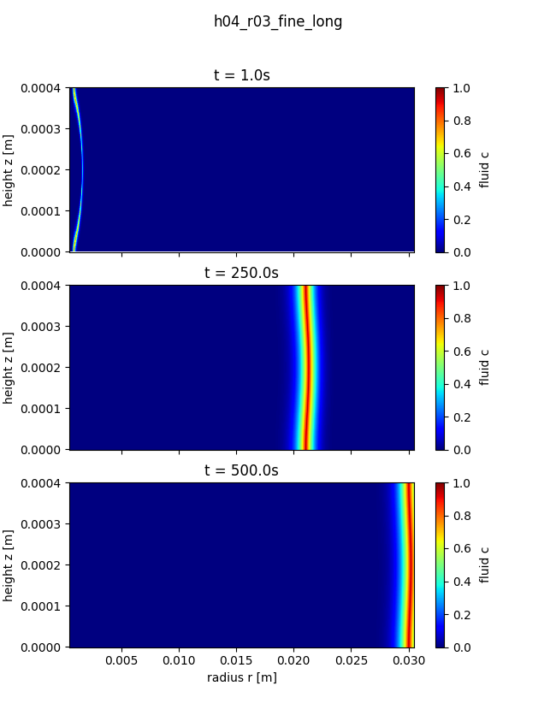
Case h = 0.4mm

Slide 4
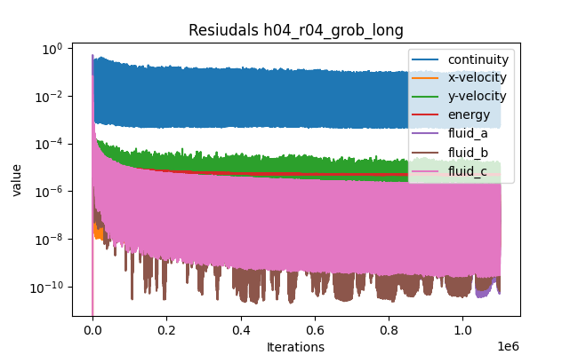
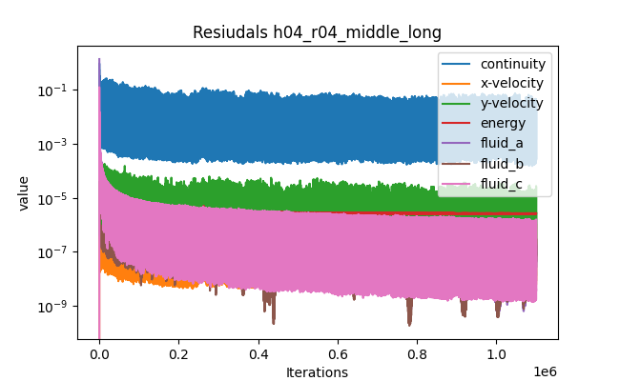
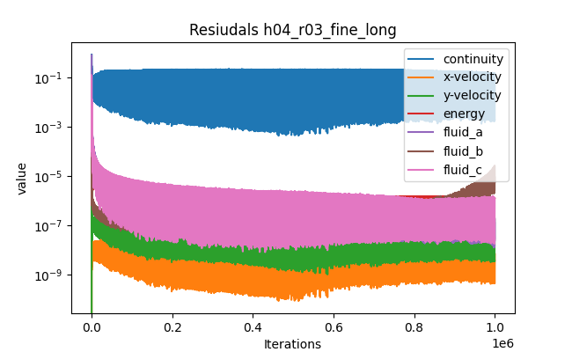
Case h = 0.4mm

Slide 5
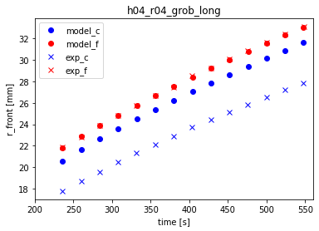
Case h = 0.4mm
Comparison with results from experiments look somewhat promising
Differences within the radial position of maximum amount of product can be seen
Results look the same for all three mesh-types

Slide 6
Thank you for your attention

